Slide 1
Temporary Pacemakers
Sue Shepard, RN, BSN
Electrophysiology Care Coordinator
Children’s Hospital San Diego, CA

Slide 2
Temporary pacemakers
Objectives
  Explain the situations when temporary pacemakers are indicated.
  Describe the principles of pacing.
  Illustrate normal and abnormal pacemaker behavior.
  Discuss the steps to be taken in troubleshooting a temporary pacemaker.

Slide 3
Indications for Temporary Pacing
Bradyarrhythmias
AV conduction block
  Congenital complete heart block (CHB)- normal or abnormal heart structure
  L-Transposition (corrected transposition)
    Bundle of His long; AV node anterior
    Prone to CHB
  Trauma- surgical or other
Slow sinus or junctional rhythm
Suppression of ectopy
Permanent pacer malfunction
Drugs, electrolyte imbalances
Sick Sinus Syndrome
  Secondary to pronounced atrial stretch
  Old TGA s/p Senning or Mustard procedure

Slide 4
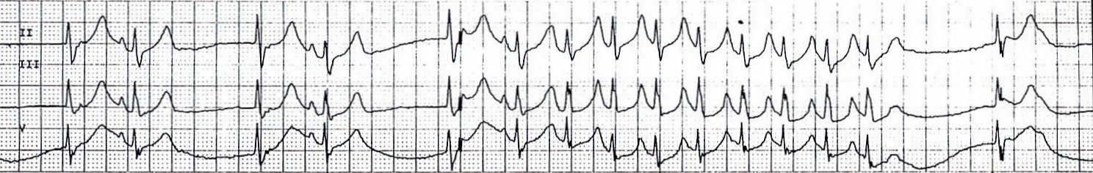
Indications for Temporary Pacing
Sick Sinus Syndrome

Slide 5
Principles of Pacing
Electrical concepts
  Electrical circuit
    Pacemaker to patient, patient to pacemaker
  Current- the flow of electrons in a completed circuit
    Measured in milliamperes (mA)
  Voltage – a unit of electrical pressure or force causing electrons to move through a circuit
    Measured in millivolts (mV)
  Impedance- the resistance to the flow of current

Slide 6
Principles of Pacing
Temporary pacing types
  Transcutaneous
    Emergency use with external pacing/defib unit
  Transvenous
    Emergency use with external pacemaker
  Epicardial
    Wires sutured to right atrium & right ventricle
    Atrial wires exit on the right of the sternum
    Ventricular wires exit on the left of the sternum

Slide 7
Principles of Pacing
Wiring systems
  Unipolar
    One electrode on the heart (-)
    Signals return through body fluid and tissue to the pacemaker (+)
  Bipolar
    Two electrodes on the heart (- & +)
    Signals return to the ring electrode (+) above the lead (-) tip

Slide 8
Principles of Pacing
Modes of Pacing
  Atrial pacing
    Intact AV conduction system required
  Ventricular pacing
    Loss of atrial kick
    Discordant ventricular contractions
    Sustains cardiac output
  Atrial/Ventricular pacing
    Natural pacing
    Atrial-ventricular synchrony

Slide 9
Principles of Pacing
3-letter NBG Pacemaker Code
  First letter: Chamber Paced
    V- Ventricle
    A- Atrium
    D- Dual (A & V)
    O- None

Slide 10
Principles of Pacing
3-letter NBG Pacemaker Code
  Second letter: Chamber Sensed
    V- Ventricle
    A- Atrium
    D- Dual (A & V)
    O- None

Slide 11
Principles of Pacing
3-letter NBG Pacemaker Code
  Third letter: Sensed Response
    T- Triggers Pacing
    I- Inhibits Pacing
    D- Dual
    O- None

Slide 12
Principles of Pacing
Commonly used modes:
  AAI - atrial demand pacing
  VVI - ventricular demand pacing
  DDD – atrial/ventricular demand pacing, senses & paces both chambers; trigger or inhibit
  AOO - atrial asynchronous pacing

Slide 13
Principles of Pacing
Atrial and ventricular output
  Milliamperes (mA)
    Typical atrial mA 5
    Typical ventricular mA 8-10
AV Interval
  Milliseconds (msec)
    Time from atrial sense/pace to ventricular pace
    Synonymous with “PR” interval
Atrial and ventricular sensitivity
  Millivolts (mV)
    Typical atrial: 0.4 mV
    Typical ventricular: 2.0mV

Slide 14
Principles of Pacing (cont.)
Atrial/ventricular rate
  Set at physiologic rate for individual patient
  AV Interval, upper rate, & PVARP automatically adjust with set rate changes
Upper rate
  Automatically adjusts to 30 bpm higher than set rate
  Prevents pacemaker mediated tachycardia from unusually high atrial rates
  Wenckebach-type rhythm results when atrial rates are sensed faster than the set rate
Refractory period
  PVARP: Post Ventricular Atrial Refractory Period
    Time after ventricular sensing/pacing when atrial events are ignored

Slide 15
Principles of Pacing
Electrical Safety
  Microshock
  Accidental de-wiring
    Taping wires
    Securing pacemaker
Removal of pacing wires
  Potential myocardial trauma
    Bleeding
      Pericardial effusion/tamponade
      Hemothorax
    Ventricular arrhythmias
Pacemaker care & cleaning
  Batteries
  Bridging cables
  Pacemakers

Slide 16
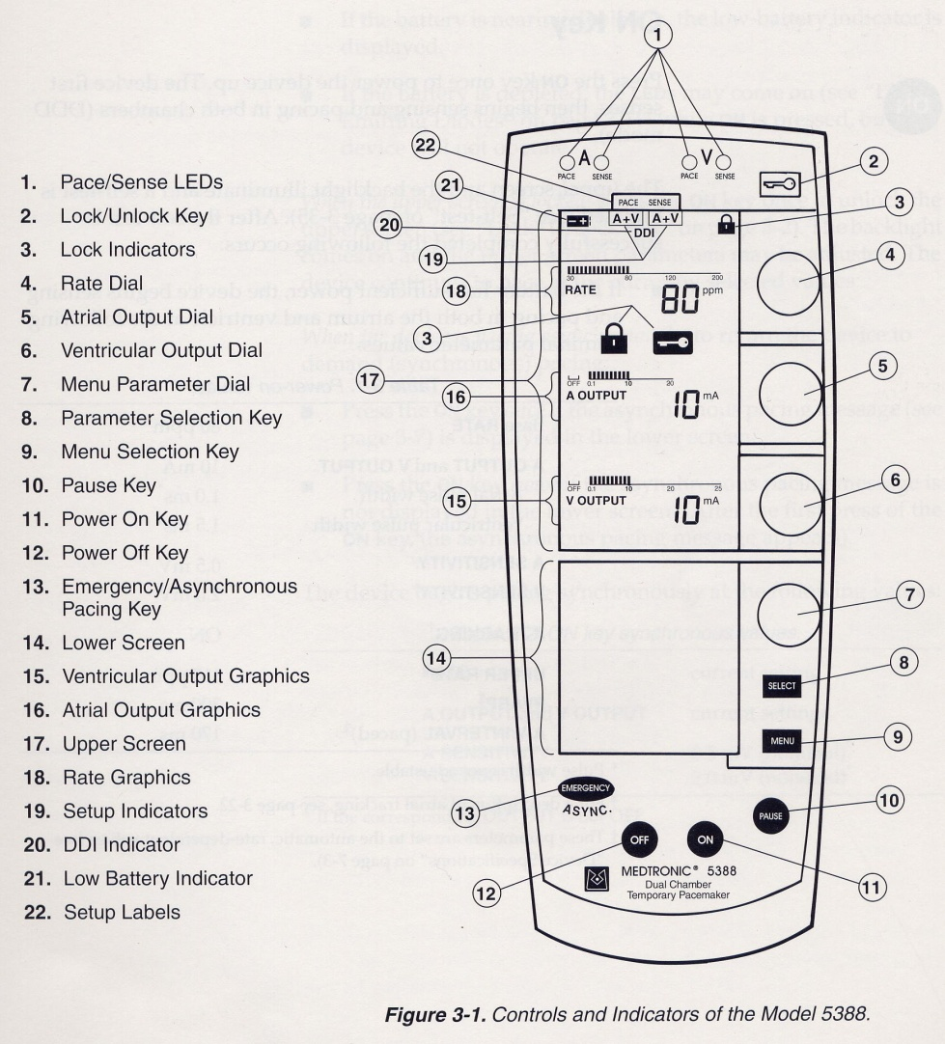
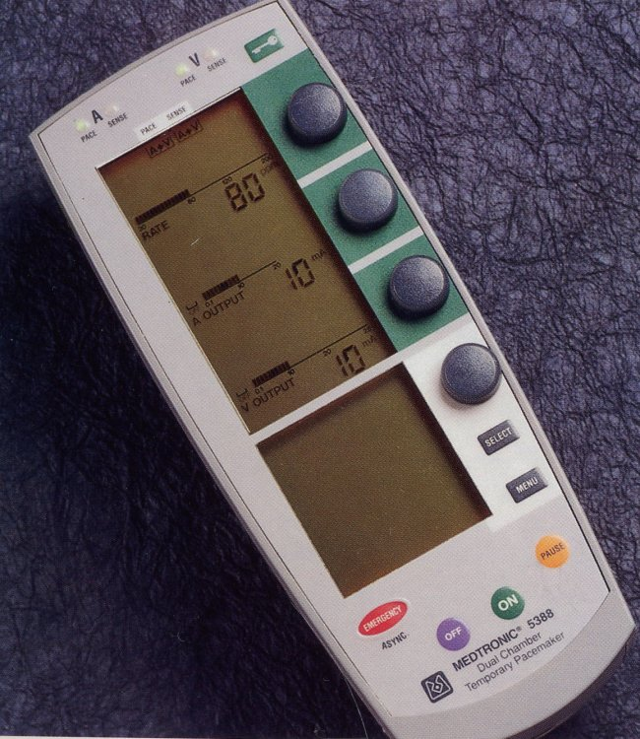
Pacemaker
Medtronic 5388 Dual Chamber (DDD)

Slide 17
Pacemaker EKG Strips
Assessing Paced EKG Strips
  Identify intrinsic rhythm and clinical condition
  Identify pacer spikes
  Identify activity following pacer spikes
  Failure to capture
  Failure to sense
EVERY PACER SPIKE SHOULD HAVE A P-WAVE OR QRS COMPLEX FOLLOWING IT.

Slide 18
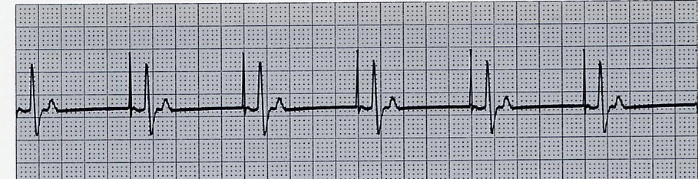
Normal Pacing
Atrial Pacing
  Atrial pacing spikes followed by P waves

Slide 19
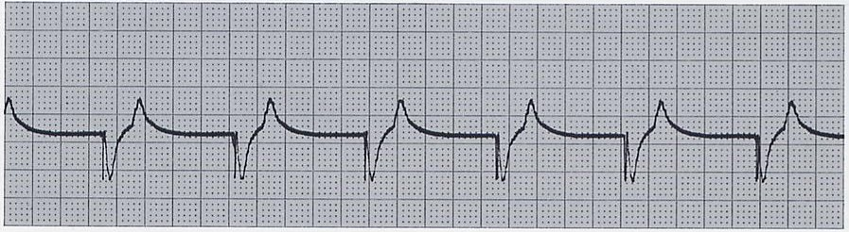
Normal Pacing
Ventricular pacing
  Ventricular pacing spikes followed by wide, bizarre QRS complexes

Slide 20
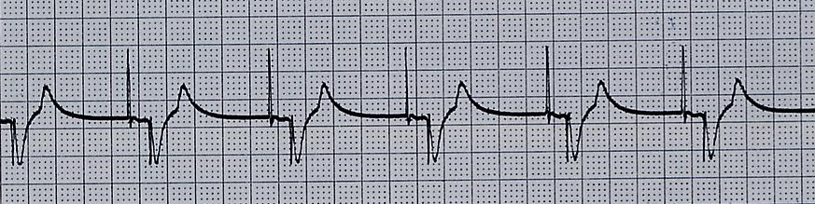
Normal Pacing
A-V Pacing
  Atrial & Ventricular pacing spikes followed by atrial & ventricular complexes

Slide 21
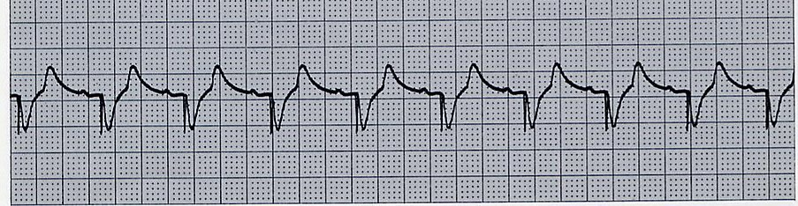
Normal Pacing
DDD mode of pacing
  Ventricle paced at atrial rate

Slide 22
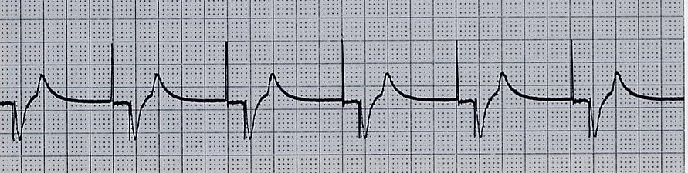
Abnormal Pacing
Atrial non-capture
  Atrial pacing spikes are not followed by P waves

Slide 23
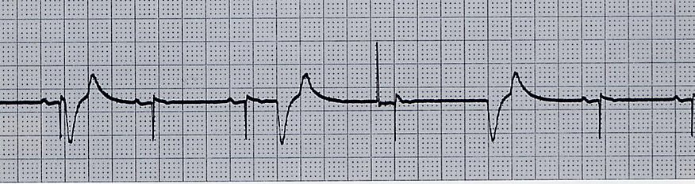
Abnormal Pacing
Ventricular non-capture
  Ventricular pacing spikes are not followed by QRS complexes

Slide 24
Failure to Capture
Causes
  Insufficient energy delivered by pacer
  Low pacemaker battery
  Dislodged, loose, fibrotic, or fractured electrode
  Electrolyte abnormalities
    Acidosis
    Hypoxemia
    Hypokalemia
Danger - poor cardiac output

Slide 25
Failure to Capture
Solutions
  View rhythm in different leads
  Change electrodes
  Check connections
  Increase pacer output (↑mA)
  Change battery, cables, pacer
  Reverse polarity

Slide 26
Reversing polarity
Changing polarity
  Requires bipolar wiring system
  Reverses current flow
  Switch wires at pacing wire/bridging cable interface
  Skin “ground” wire

Slide 27
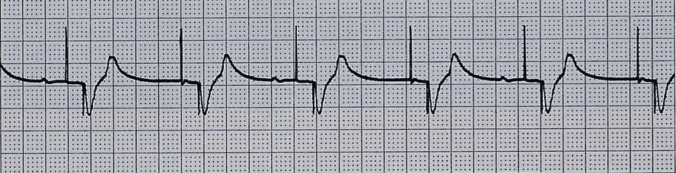
Abnormal Pacing
Atrial undersensing
  Atrial pacing spikes occur regardless of P waves
  Pacemaker is not “seeing” intrinsic activity

Slide 28
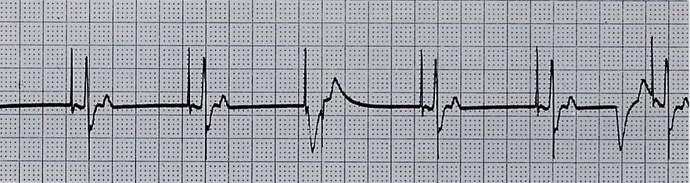
Abnormal Pacing
Ventricular undersensing
  Ventricular pacing spikes occur regardless of QRS complexes
  Pacemaker is not “seeing” intrinsic activity

Slide 29
Failure to Sense
Causes
  Pacemaker not sensitive enough to patient’s intrinsic electrical activity (mV)
  Insufficient myocardial voltage
  Dislodged, loose, fibrotic, or fractured electrode
  Electrolyte abnormalities
  Low battery
  Malfunction of pacemaker or bridging cable

Slide 30
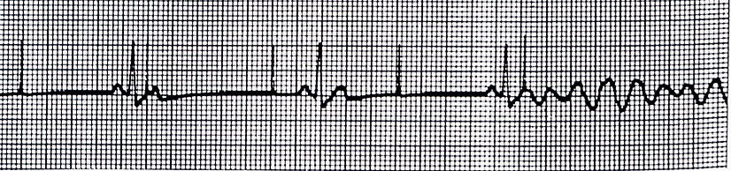
Failure to Sense
Danger – potential (low) for paced ventricular beat to land on T wave

Slide 31
Failure to Sense
Solution
  View rhythm in different leads
  Change electrodes
  Check connections
  Increase pacemaker’s sensitivity (↓mV)
  Change cables, battery, pacemaker
  Reverse polarity
  Check electrolytes
  Unipolar pacing with subcutaneous “ground wire”

Slide 32
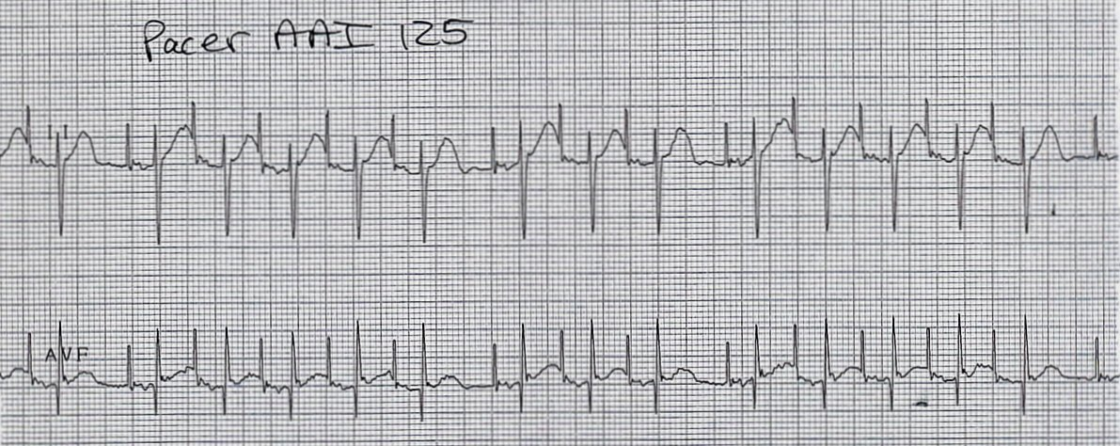
Oversensing
Pacing does not occur when intrinsic rhythm is inadequate

Slide 33
Oversensing
Causes
  Pacemaker inhibited due to sensing of “P” waves & “QRS” complexes that do not exist
  Pacemaker too sensitive
  Possible wire fracture, loose contact
  Pacemaker failure
Danger - heart block, asystole

Slide 34
Oversensing
Solution
  View rhythm in different leads
  Change electrodes
  Check connections
  Decrease pacemaker sensitivity (↑mV)
  Change cables, battery, pacemaker
  Reverse polarity
  Check electrolytes
  Unipolar pacing with subcutaneous “ground wire”

Slide 35
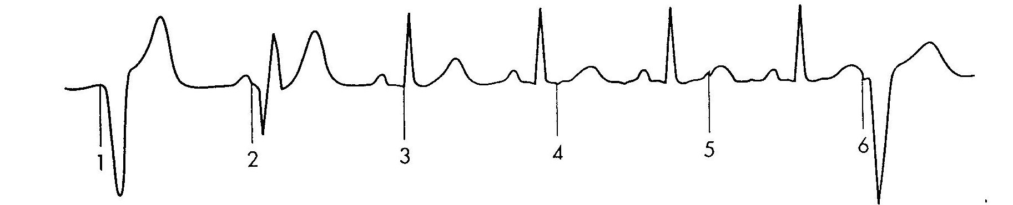
Competition
Assessment
  Pacemaker & patient’s intrinsic rate are similar
  Unrelated pacer spikes to P wave, QRS complex
  Fusion beats

Slide 36
Competition
Causes
  Asynchronous pacing
  Failure to sense
  Mechanical failure: wires, bridging cables, pacemaker
  Loose connections
Danger
  Impaired cardiac output
  Potential (low) for paced ventricular beat to land on T wave

Slide 37
Competition
Solution
  Assess underlying rhythm
    Slowly turn pacer rate down
  Troubleshoot as for failure to sense
  Increase pacemaker sensitivity (↓mV)
  Increase pacemaker rate

Slide 38
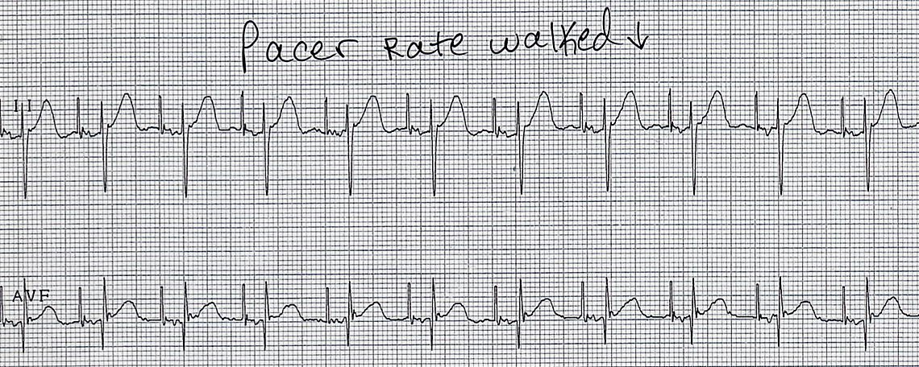
Assessing Underlying Rhythm
Carefully assess underlying rhythm
  Right way: slowly decrease pacemaker rate

Slide 39
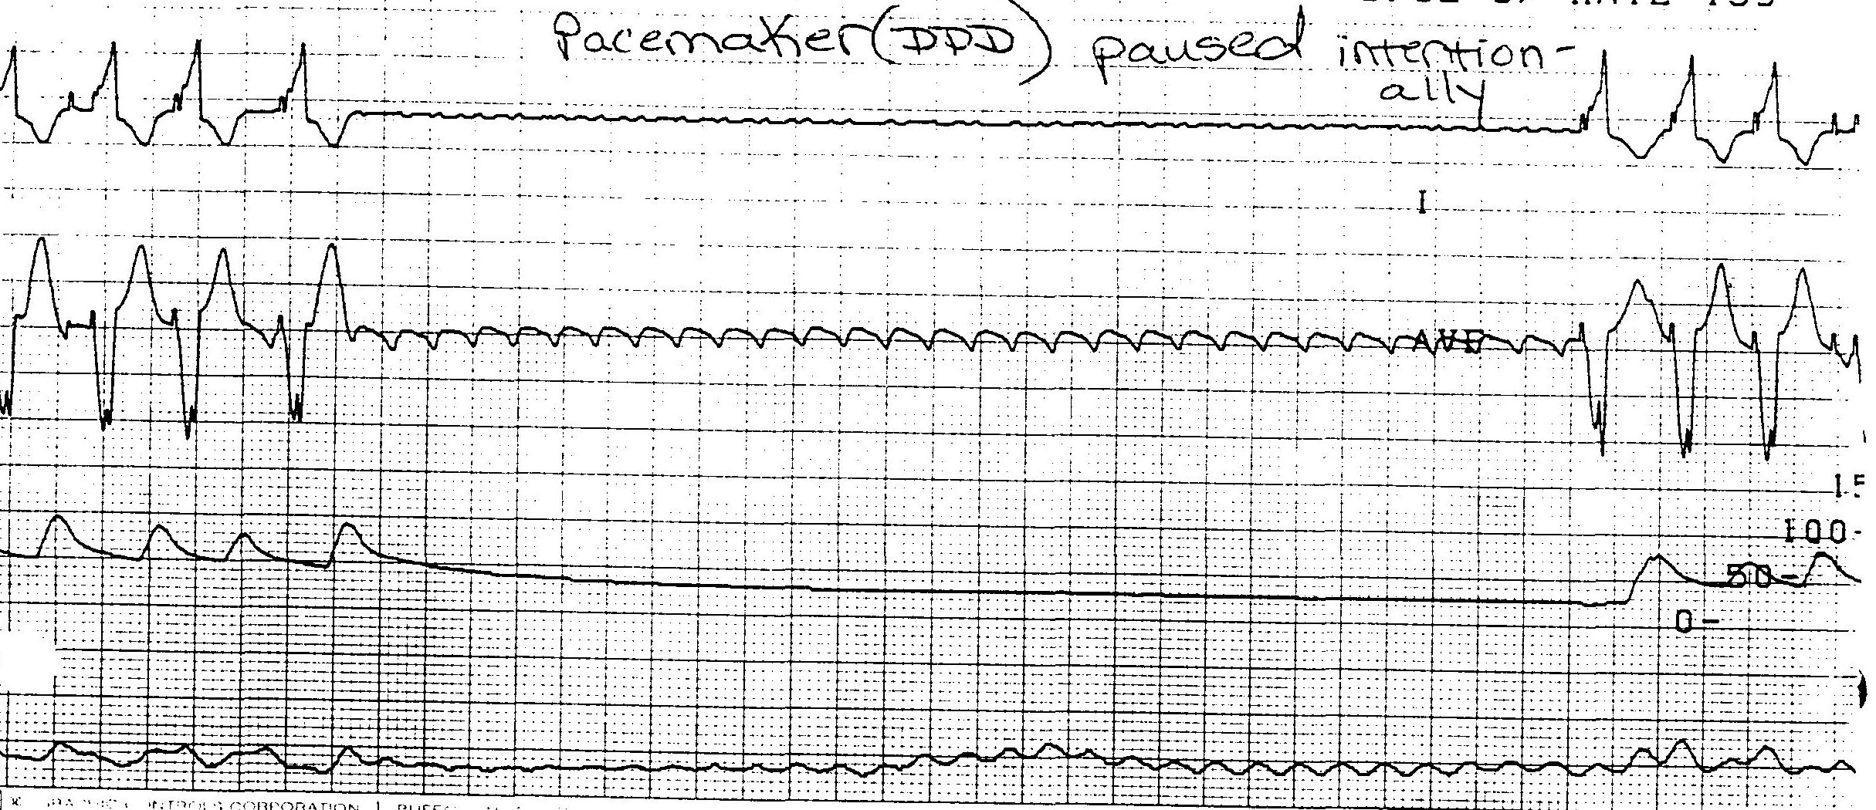
Assessing Underlying Rhythm
Assessing Underlying Rhythm
  Wrong way: pause pacer or unplug cables

Slide 40
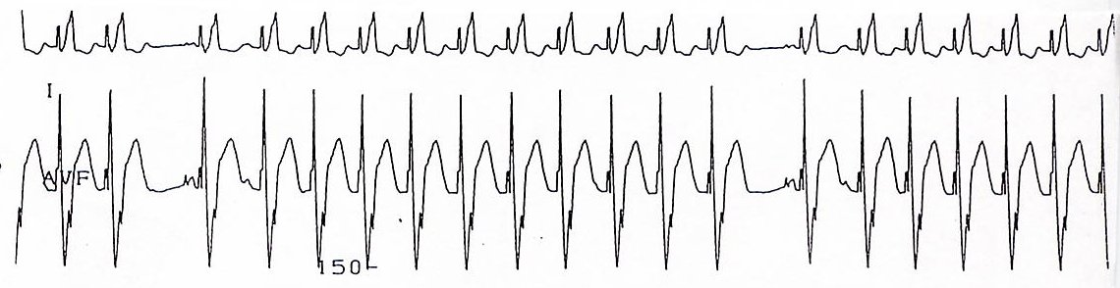
Wenckebach
Assessment
  Appears similar to 2nd degree heart block
  Occurs with intrinsic tachycardia

Slide 41
Wenckebach
Causes
  DDD mode safety feature
  Prevents rapid ventricular pacing impulse in response to rapid atrial rate
    Sinus tachycardia
    Atrial fibrillation, flutter
    Prevents pacer-mediated tachycardia
    Upper rate limit may be inappropriate

Slide 42
Wenckebach
Solution
  Treat cause of tachycardia
    Fever: Cooling
    Atrial tachycardia: Anti-arrhythmic
    Pain: Analgesic
    Hypovolemia: Fluid bolus
  Adjust pacemaker upper rate limit as appropriate

Slide 43
Threshold testing
Stimulation threshold
  Definition: Minimum current necessary to capture & stimulate the heart
  Testing
    Set pacer rate 10 ppm faster than patient’s HR
    Decrease mA until capture is lost
    Increase output until capture is regained (threshold capture)
    Output setting to be 2x’s threshold capture
      Example: Set output at 10mA if capture was regained at 5mA

Slide 44
Performing an AEG
Purpose: Determine existence & location of P waves
Direct EKG from atrial pacing wires
  Bedside EKG from monitor
  Full EKG
Atrial pacing pins to RA & LA EKG lead-wires

Slide 45
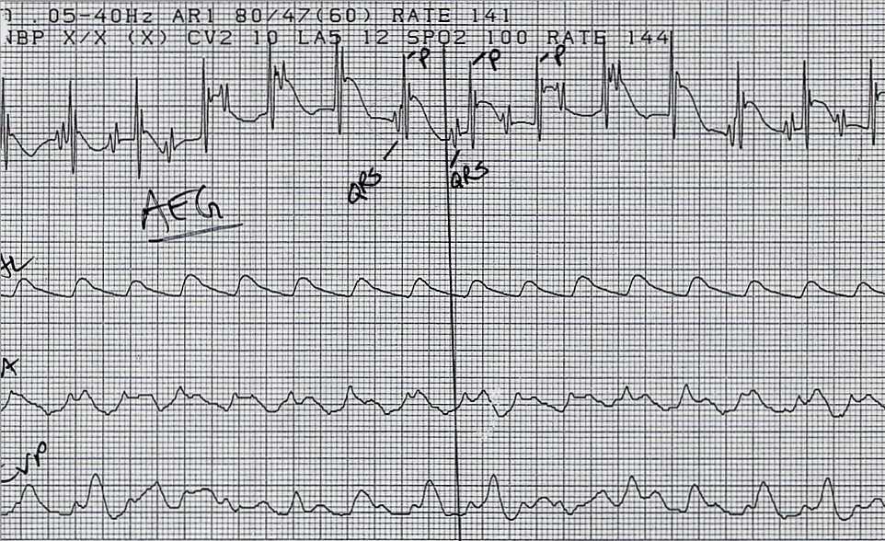
Interpreting an AEG

Slide 46
Sensitivity Threshold
Definition: Minimum level of intrinsic electric activity generated by the heart detectable by the pacemaker

Slide 47
Sensitivity Threshold Testing
Testing
  Set pacer rate 10 ppm slower than patient’s HR
  Increase sensitivity to chamber being tested to minimum level (0.4mV)
  Decrease sensitivity of the pacer (↑mV) to the chamber being tested until pacer stops sensing patient (orange light stops flashing)
  Increase sensitivity of the pacer (↓mV) until the pacer senses the patient (orange light begins flashing). This is the threshold for sensitivity.
  Set the sensitivity at ½ the threshold value.
    Example: Set sensitivity at 1mV if the threshold was 2mV

Slide 48
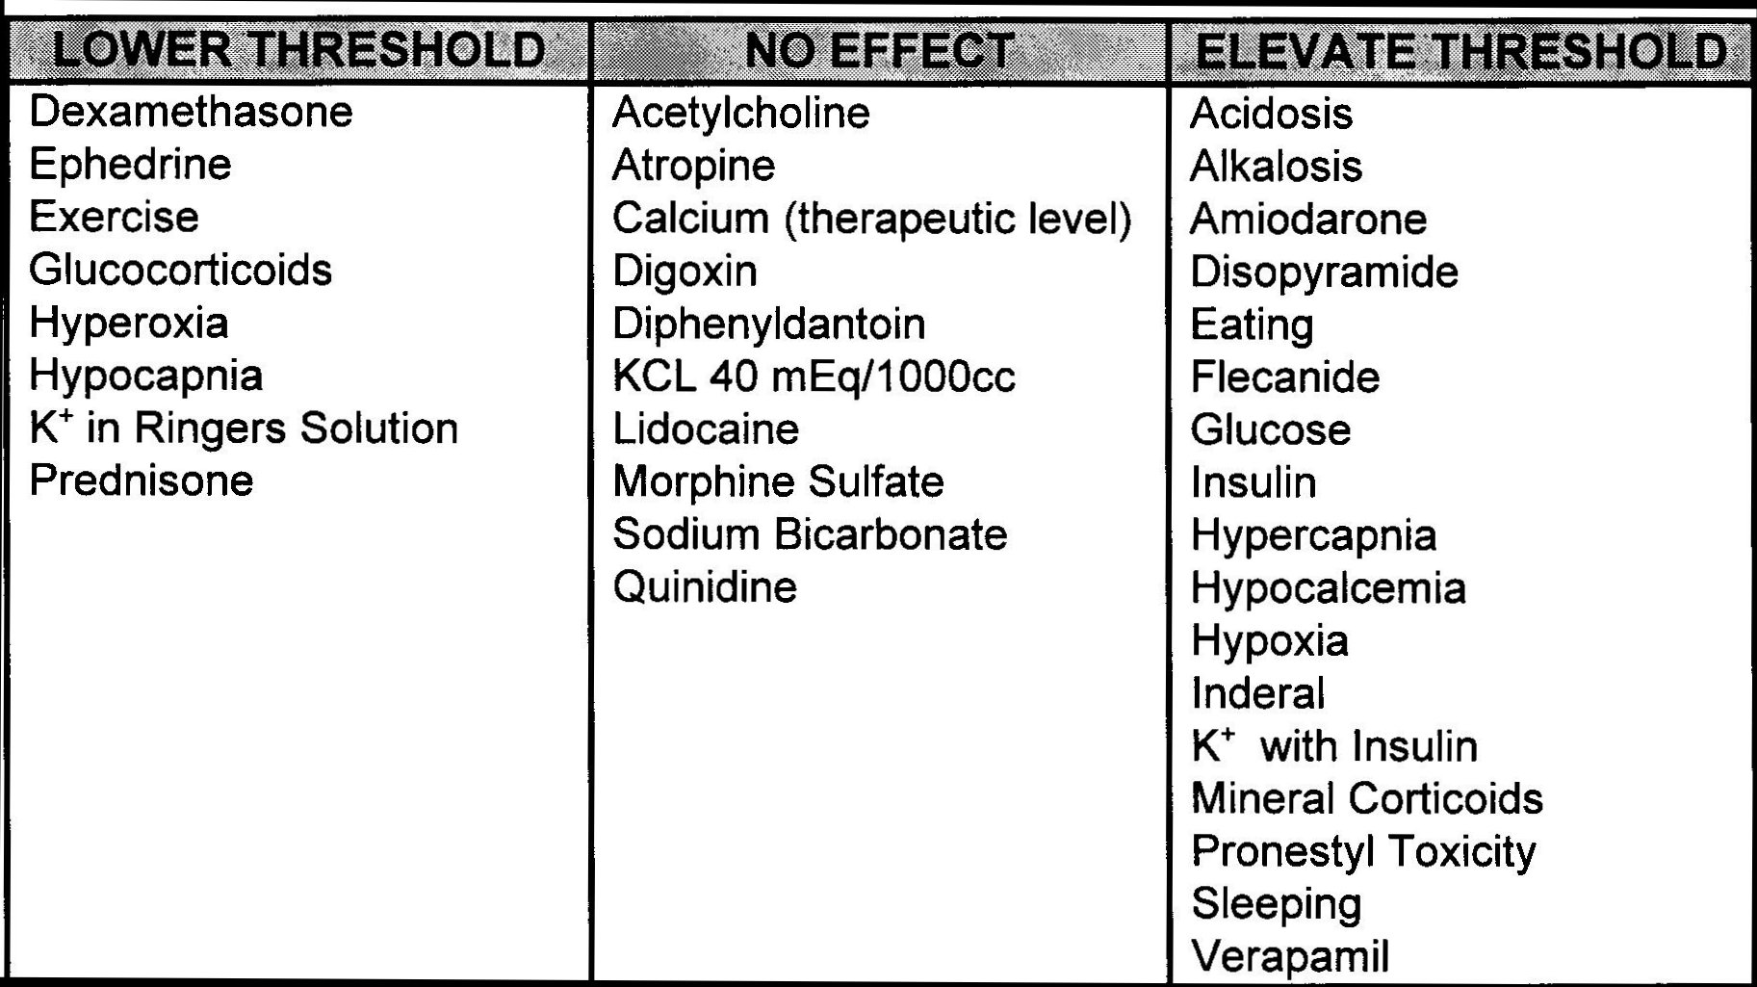
Factors Affecting Stimulation Thresholds

Slide 49
Practice Strip#1

Slide 50
Practice Strip #2

Slide 51
Practice Strip #3

Slide 52
Practice Strip #4

Slide 53
Practice Strip #5

Slide 54
Practice Strip #6

Slide 55
Practice Strip #7

Slide 56
Practice Strip #8

Slide 57
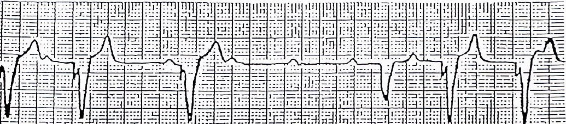
Practice Strip #9

Slide 58
Answers
Mode of pacing, rhythm/problem, solution
AAI: normal atrial pacing
Sinus rhythm: no pacing; possible back-up setting AAI, VVI, DDD
DDD: failure to sense ventricle; increase ventricular mA
VVI: ventricular pacing
DDD: failure to capture atria or ventricle; increase atrial & ventricular mA
DDD: normal atrial & ventricular pacing
DDD: normal atrial sensing, ventricular pacing
DDD: failure to capture atria; increase atrial mA
DDD: oversensing; decrease ventricular sensitivity

Slide 59
References
Conover, M. Understanding Electrocardiography, (6th Ed.). Mosby Year Book; 1992.
Hazinski, M. F. Nursing Care of the Critically Ill Child, (2nd Ed.). Mosby Year Book; 1992.
Heger, J., Niemann, J., Criley, J. M. Cardiology for the House Officer, (2nd Ed.).
Williams and Wilkins; 1987.
Intermedics Inc. Guide to DDD Pacing, 1985.
Moses, H. W., Schneider, J., Miller, B., Taylor, G. A Practical Guide to
Cardiac Pacing, (3rd Ed.). Boston: Little, Brown, and Co.; 1991.
Merva, J. A. Temporary pacemakers. RN. May, 1992.

