Slide 1
The Very Basics of Pacing
Glenn Estell
Medtronic
Pribcipal Clinical Specialist.

Slide 2
Cardiac Conduction System
Notes:
Sinoatrial Node (SA Node)
Located in the right atrium
Dominant pacemaker of the heart
Atrioventricular Node (AV Node)
Located near the juncture of the right atrium and ventricle
Receives the impulse generated by the SA node
Delays the impulse conduction to allow time for full atrial contraction
Bundle of His and R. and L. Bundle Branches
Located along the interventricular septum
Receive the electrical impulse from the AV node and conduct it down into the ventricles
Purkinje fibers
Muscle fibers arising from the bundle branches
Transmit the electrical impulse to the ventricles

Slide 3
Normal Sinus Rhythm
Normal Heart Rate: 60-100 bpm
  SA node fires
  Each impulse causes atrial depolarization (atrial contraction)
  Impulses travel through the AV node and cause ventricular
  depolarization (ventricular contraction)
Notes:
Normal sinus rhythm
1:1 antegrade conduction
Normal rate 60-100 bpm
PR interval: 120-200 ms (.12-.20 seconds)
QRS interval: 60-100 ms (.06-.10 seconds)
QT interval: 360-440 ms (.36-.44 seconds)

Slide 4
Sinus Bradycardia
Persistent slow rate from the SA node.
Heart rate less than 60 bpm
Notes:
Bradycardia means that the heart's natural rhythm has become abnormally slow (less than 60 beats per minute). Because of this, the heart may not be able to meet the body's demands, resulting in symptoms such as dizziness, extreme fatigue, shortness of breath, or fainting spells.
It may be that the sinus node, the heart's natural pacemaker, sends out electrical impulses too slowly. Or, the electrical impulses may be blocked along the pathway through the heart, resulting in a condition called heart block. The heartbeat then becomes very slow or unsteady.
Either of these two conditions - which are both forms of bradycardia -can result from heart disease, damage from a heart attack, cardiac surgery, or degeneration from the aging process. The precise cause may be unknown. This rhythm may also be normal if no symptoms are occurring.
Whatever the cause of symptomatic bradycardia, a pacemaker can maintain the proper heartbeat to sustain normal living, and will relieve the symptoms typically associated with sick sinus syndrome or heart block.

Slide 5
Sinus Arrest
2.8-second arrest
Failure of sinus node discharge
resulting in the absence of atrial depolarization and periods of ventricular asystole
Notes:
Sinus arrest occurs when there is a pause in the rate at which the SA node fires. With sinus arrest there is no relationship between the pause and the basic cycle length.
In this example:
Rate = 75 bpm
PR interval = 180 ms (.18 seconds)
2.8-second arrest

Slide 6
Bradycardia-Tachycardia
Brady-Tachy Syndrome
Sick Sinus Syndrome (SSS)
Intermittent episodes of slow and fast rates from the SA node or atria
  Rate during bradycardia = 43 bpm
  Rate during tachycardia = 130 bpm
Notes:
Brady-tachy syndrome (Sick sinus Syndrome) occurs when the SA node has alternating periods of firing too slowly (< 60 bpm) and too fast (> 100 bpm). Brady-tachy syndrome often manifests itself in periods of atrial tachycardia, flutter, or fibrillation. Cessation of the tachycardia is often followed by long pauses from the SA node.
Sick sinus syndrome - A heart rhythm disturbance that results from an impaired SA node. If the SA node, the heart's natural pacemaker, loses the ability to initiate a heartbeat or increase the heart rate, the heart may not be able to respond effectively to the body's changing circulation demands.
In response to sick sinus syndrome, other tissues in the heart often take over the role of the SA node, but at an inconsistent rate or a rate that is too slow or too fast for normal activities. SA node disease results in a condition called symptomatic bradycardia, in which the heart beats at less than 60 beats per minute. A pacemaker can correct the effects of this condition.

Slide 7
Complete Heart Block
No impulse conduction from the atria to the ventricles.
  Ventricular rate = 37 bpm
  Atrial rate = 130 bpm
Notes:
Third Degree AV Block is also called Complete Heart Block
SA node fires
Atrial depolarization takes place (P-wave)
Impulse reaches the AV node or the His Bundle where they are completely blocked. The escape pacemaker initiates impulses to cause ventricular depolarization (R-wave) - called a junctional or ventricular rhythm.
P waves are present, but may be distorted by or buried in the QRS complex or T-wave
P-P interval is constant
Atrial rate varies (60 - 100 bpm)
If the junctional rhythm assumes control (heart pacemaker controlled by the AV junction area) - then the QRS duration will be normal. [rate of 40 - 60 bpm]
If the ventricular rhythm assumes control - the QRS duration will be longer than normal (> 100 ms) [rate of 40 bpm or less]
No A-V association = AV dissociation

Slide 8
NBG Code
I
II
III
IV
V
Chamber
Chamber
Response
Programmable
Antitachy
Paced
Sensed
to Sensing
Functions/Rate
Function(s)
Modulation
V: Ventricle
V: Ventricle
T: Triggered
P: Simple
programmable
P: Pace
A: Atrium
A: Atrium
I: Inhibited
M: Multi-
programmable
S: Shock
D: Dual (A+V)
D: Dual (A+V)
D: Dual (T+I)
C: Communicating
D: Dual (P+S)
O: None
O: None
O: None
R: Rate modulating
O: None
S: Single
(A or V)
S: Single
(A or V)
O: None
Notes:
The first letter refers to the chamber(s) being paced
The second letter refers to the chamber(s) being sensed
The third letter refers to the pacemaker’s response to a sensed event:
T = Triggered D = Dual (inhibited and triggered*)
I = Inhibited O = No response
*In a single chamber mode, “triggered” means that when an intrinsic event is sensed, a pace is triggered immediately thereafter. In a dual chamber mode, “triggered” means that a sensed atrial event will initiate (trigger) an A-V delay.
The fourth letter denotes the pacemaker’s programmability and whether it is capable of rate response:
P = Simple Programmable (rate and/or output)
M = Multiprogrammable (rate, output, sensitivity, etc.)
C = Communicating (pacemaker can send/receive information to/from the programmer)
R = Rate Modulation
O = None
Note that this sequence is hierarchical. In other words, it is assumed that if a pacemaker has rate modulation capabilities, “R”, that it also can communicate, “C”.
The fifth letter represents the pacemaker’s antitachycardia functions:
P = Pace D = Dual (pace and shock available)
S = Shock O = None
You may want to test the audience by having them describe different pacing modes. More modes and ECG strips are found in Module 2.

Slide 9
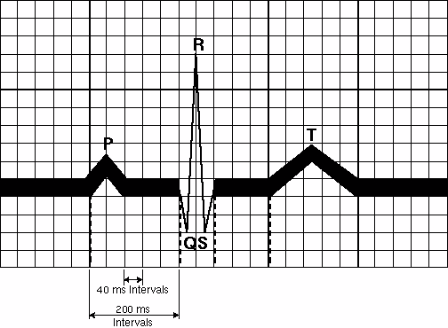
Intervals Are Often Expressed in Milliseconds
One millisecond = 1 / 1,000 of a second
Notes:
Part of understanding timing intervals requires an acquaintance with milliseconds. Many healthcare professionals are accustomed to measuring intervals in seconds. Timing intervals in pacing, however, are always measured in milliseconds. The exception to this is lower and upper rates, which are usually expressed in beats per minute/bpm.
The graphic above shows intervals in milliseconds of a normal sinus beat. The entire graph represents 1000 milliseconds or one second of time.
The smallest box on the ECG represents 40 milliseconds or .04 seconds. The medium box represents 200 milliseconds or .2 seconds.

Slide 10
Converting Rates to Intervals and Vice Versa
Rate to interval (ms):
  60,000/rate (in bpm) = interval (in milliseconds)
  Example: 60,000/100 bpm = 600 milliseconds
Interval to rate (bpm):
  60,000/interval ( in milliseconds) = rate (bpm)
  Example: 60,000/500 ms = 120 bpm
Notes:
The way to convert bpm to milliseconds is to divide the rate into 60,000 (the number of milliseconds in one minute). Converting an interval in milliseconds to a rate in bpm is done by dividing 60,000 by the millisecond interval.

Slide 11
A Unipolar Pacing System Contains a Lead with Only One Electrode Within the Heart; In This System, the Impulse:
Flows through the tip electrode (cathode)
Stimulates the heart
Returns through body fluid and tissue to the IPG (anode)
+
Anode
-
Cathode
Notes:
In the unipolar system, the impulse:
Travels down the lead wire to stimulate the heart at the tip electrode also referred to as the cathode (–)
Returns to the metal casing of the impulse generator or the anode (+) by way of body fluids
The flow of the impulse makes a complete circuit.

Slide 12
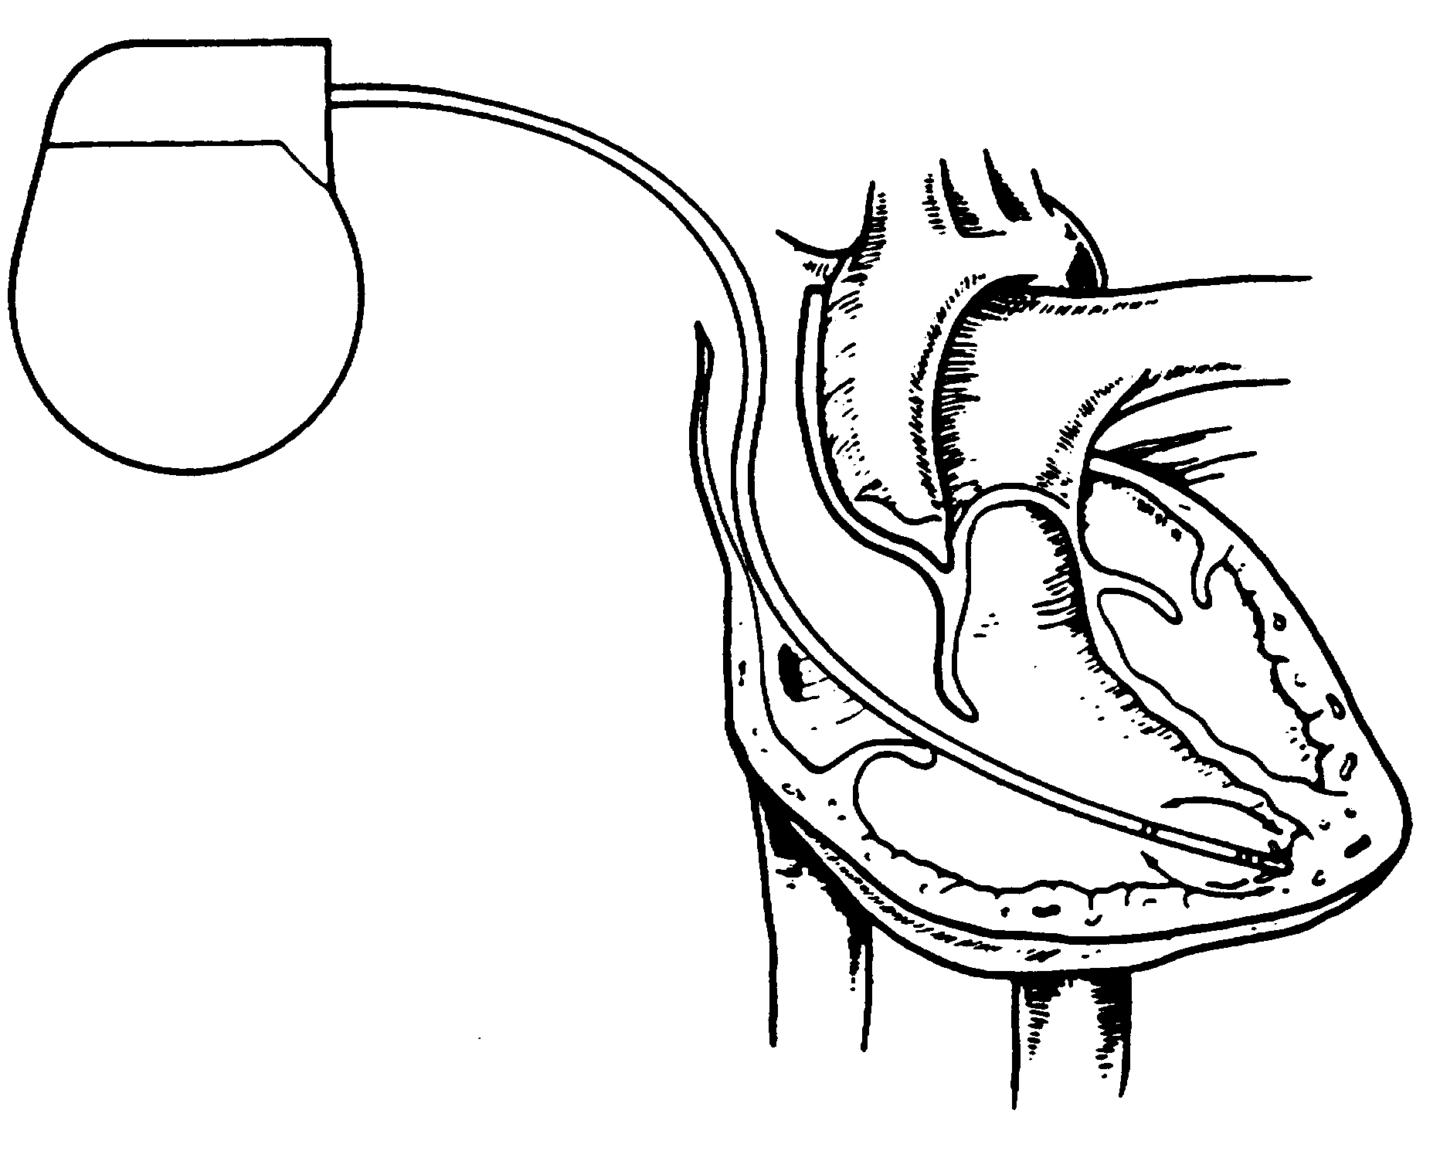
A Bipolar Pacing System Contains a Lead with Two Electrodes Within the Heart. In This System, the Impulse:
Flows through the tip electrode located at the end of the lead wire
Stimulates the heart
Returns to the ring electrode above the lead tip
Anode
Cathode
Notes:
The impulse:
Travels down the lead wire to stimulate the heart at the tip electrode, which is the cathode (–)
Travels to the ring electrode, which is the anode (+), located several inches above the lead tip
Returns to the pulse generator by way of the lead wire

Slide 13
Paced Rhythm Recognition
AAI / 60

Slide 14
Paced Rhythm Recognition
DDD / 60 / 120
Notes:
The notation at the top refers to mode, lower rate, and upper rate parameters. This mode of operation can be described as atrial synchronous pacing or atrial tracking.

Slide 15
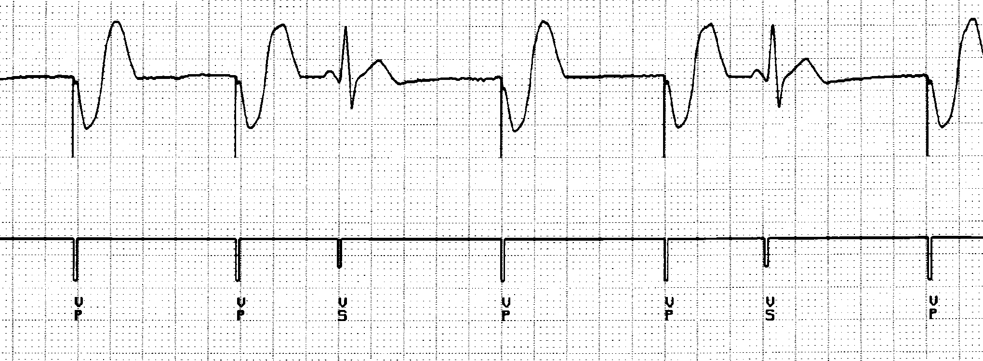
Paced Rhythm Recognition
VVI / 60

Slide 16
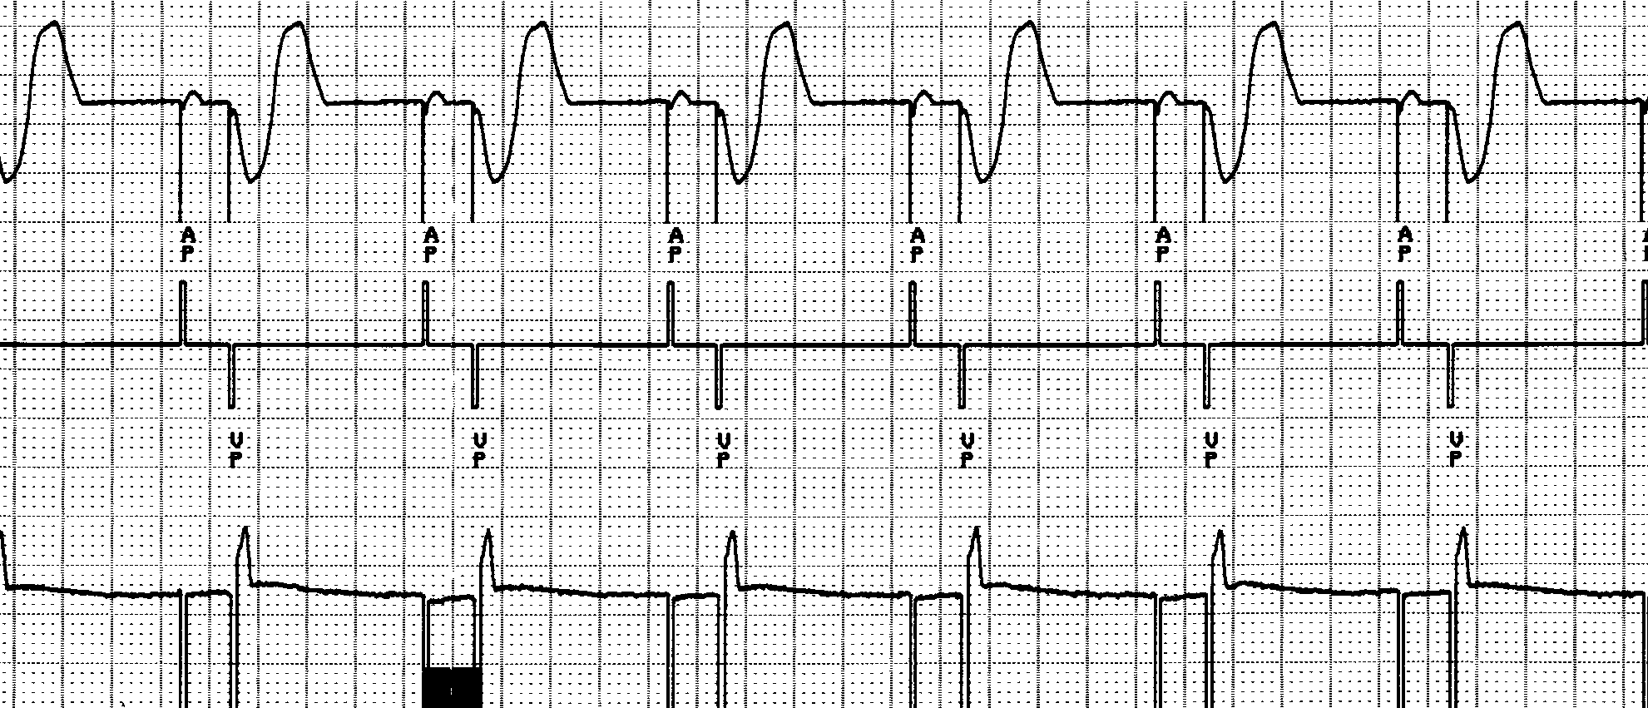
Paced Rhythm Recognition
DDD / 60 / 120
Notes:
Pacing in the atrium and ventricle is often described as AV sequential pacing.

Slide 17
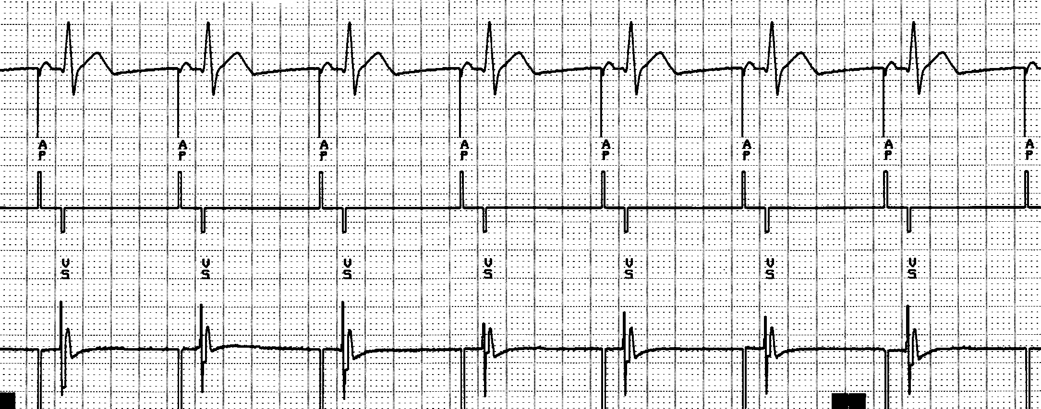
Paced Rhythm Recognition
DDD / 60 / 120

Slide 18
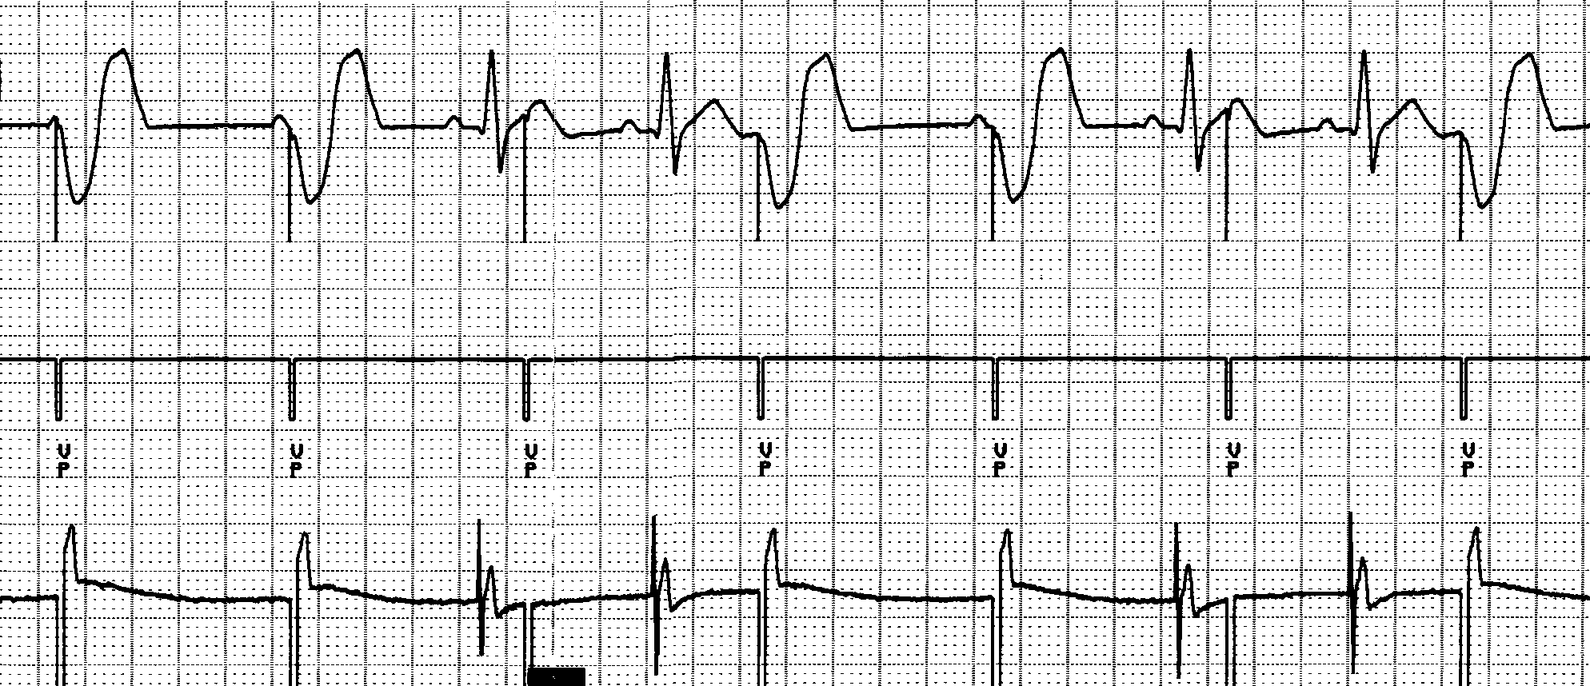
Undersensing . . .
Pacemaker does not “see” the intrinsic beat, and therefore does not respond appropriately
Scheduled pace delivered
Intrinsic beat not sensed
VVI / 60

Slide 19
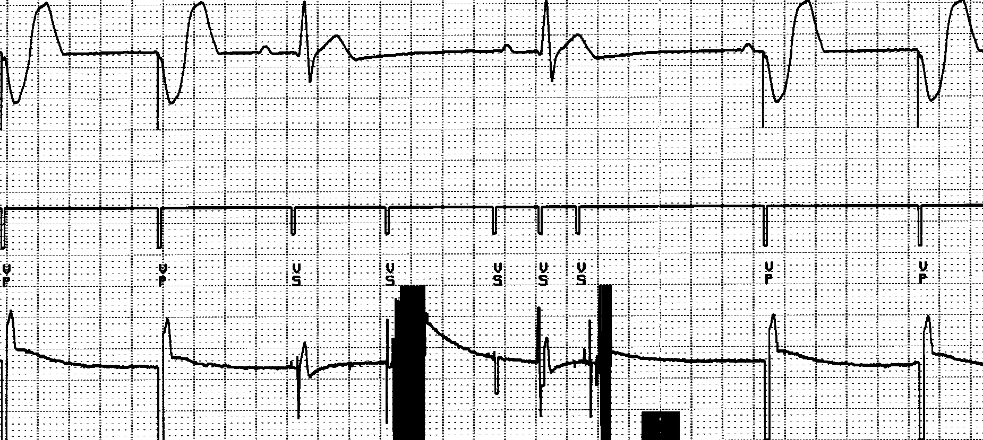
Oversensing
...though no activity is present
Marker channel shows intrinsic activity...
An electrical signal other than the intended P or R wave is detected
VVI / 60
Notes:
Oversensing will exhibit pauses in single chamber systems. In dual chamber systems, atrial oversensing may cause fast ventricular pacing without P waves preceding the paced ventricular events.

Slide 20
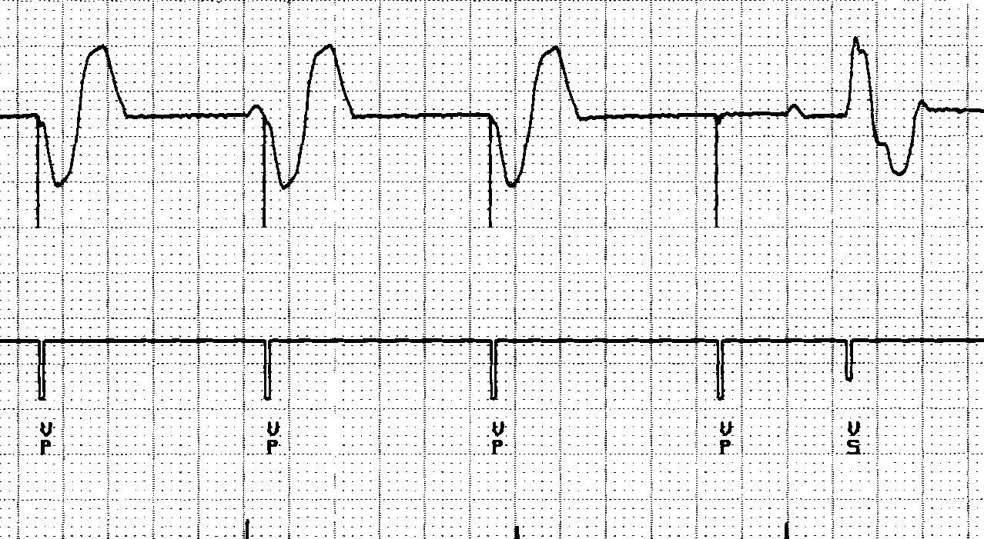
Stimulation Threshold
The minimum electrical stimulus needed to consistently capture the heart outside of the heart’s refractory period
Capture
Non-Capture
VVI / 60

Slide 21
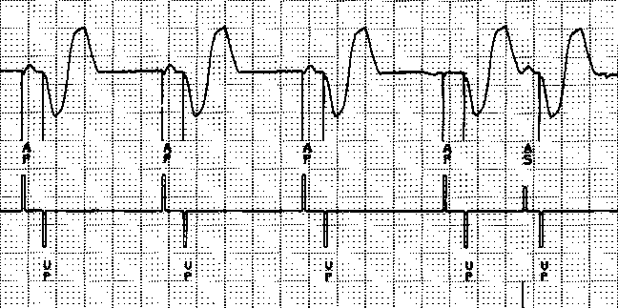
Noncapture is Exhibited By:
No evidence of depolarization after pacing artifact
Loss of capture
Notes:
This ECG strip shows loss of atrial capture, followed by a scheduled ventricular pace. Following the ventricular pulse, the marker channel recorded an intrinsic
P-wave.

Slide 22
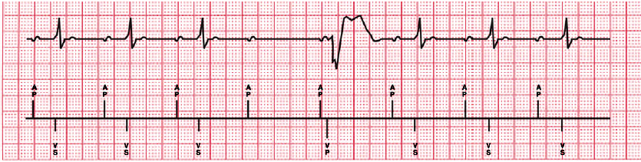
MVP Basic Operation
Ventricular Backup Ventricular pacing only as needed in the presence of
transient loss of conduction
Notes:
Ventricular Backup Figure: For occasional, single, non-conducted normal atrial contractions, the device will provide backup ventricular pacing to ensure ventricular support.
Details provided on the scheduling of backup V-paces provided on subsequent slides.

Slide 23
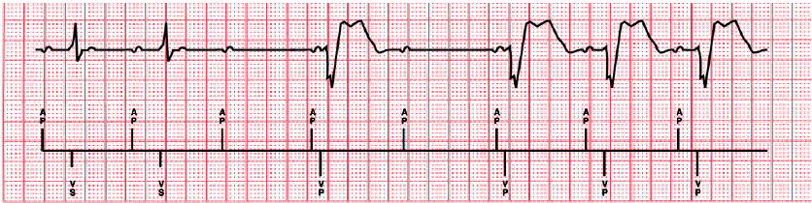
MVP Basic Operation
DDD(R) Switch Ventricular support if loss
of A-V conduction is persistent
Notes:
DDD(R) Switch Figure: If your patient develops persistent loss of conduction, the device will automatically switch to DDD(R) operation, but continue to periodically look for restored conduction.
Details on this switch provided in subsequent slides.

Slide 24
Questions ?

